Slide 1
Structural Change, Productivity, and Poverty Reduction
John Page
The Brookings Institution
Presented at the REPOA Conference on
“Productivity, Employment and Socioeconomic Security”.
Dar es Salaam, 30 March 2011

Slide 2
Rediscovering Structural Change
Structural change – the movement of resources from low productivity to high productivity employment - is a foundational idea of development economics (Kuznets, Lewis, Chenery)
Historical and cross country evidence suggests that it should be most relevant for countries at low levels of income
As incomes rise, productivity differences among sectors (and enterprises) tend to converge

Slide 3
Rediscovering Structural Change
Academic interest in structural change waned in the 1980s
Cross country regressions consigned it to the “residual”
The result for public policy was a focus on “whole economy” drivers of growth such as openness, institutions, governance, etc.
These prescriptions proved to be of little practical relevance to public policy

Slide 4
Rediscovering Structural Change
Recent academic research has rediscovered the importance of differences in productivity levels among firms (Hsieh and Klenow)
Very recently, some academic attention has returned to the implications of productivity differences between sectors (McMillan and Rodrik).

Slide 5
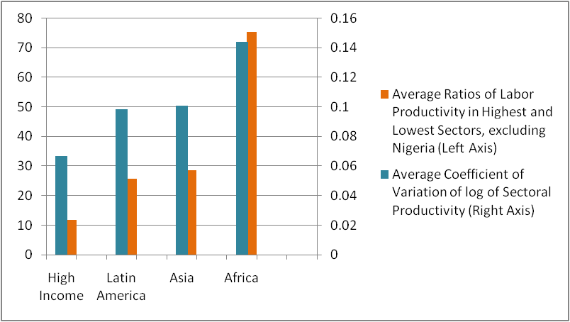
Africa has the most to gain from structural change
Productivity differences among sectors are greatest

Slide 6
A simple decomposition
    Δ Y = Σ θ i ,t-k Δ y i, t + Σ y i, t Δ θ i, t
Overall = Within Sector + Structural
Productivity Productivity Change
Change Change
Yields a worrisome result

Slide 7
Decomposition of productivity growth, unweighted averages, 1990‐2005
 | Labor productivity growth | Due to within sector productivity growth | Due to structural change
ASIA | 3.87% | 3.31% | 0.57%
HIGH INCOME | 1.46% | 1.54% | ‐0.09%
LAC | 1.35% | 2.24% | ‐0.88%
AFRICA | 0.86% | 2.13% | ‐1.27%
Source: McMillan and Rodrik (2011)

Slide 8
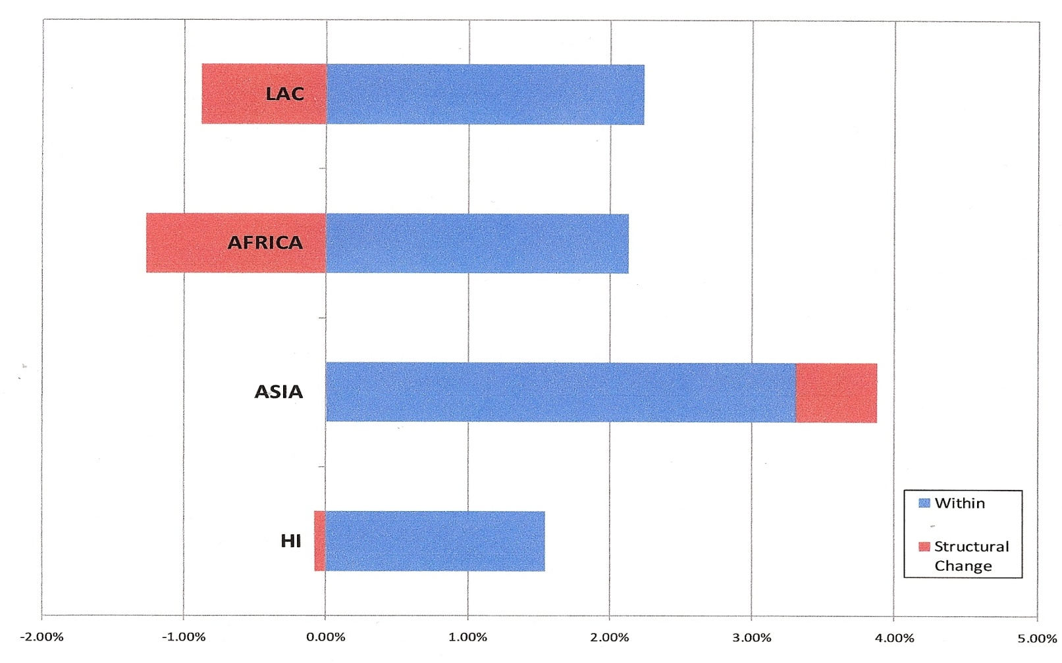
“Perverse” structural change slows productivity growth
Source: McMillan and Rodrik (2011)

Slide 9
Structural Change and Poverty Reduction
Higher productivity creates scope for poverty reduction through rising real wages
But productivity increases within sectors or firms may result in a net reduction in employment
Where the workers displaced go can have an important impact on poverty outcomes – the extreme case is unemployment
The recent experience of Latin America and Africa suggests that workers are moving to lower productivity jobs

Slide 10
Labor productivity and poverty reduction
Rate of Poverty Reduction = 0.77 – 0.83*Growth of Labor Productivity: t= -1.28 r2 = 0.0615

Slide 11
Structural change and poverty reduction
Rate of Poverty Reduction = -2.17 – 2.68*Structural Change:
t = -4.06 , r2 = 0.3979

Slide 12
Policy, strategy and structural change
The focus on “whole economy” reforms and on within sector (or firm) productivity has led to an extreme focus on the “investment climate”
Investment climate reforms focus on
  Institutional and policy reforms – “doing business”
  Infrastructure and education
Beyond the investment climate
  Many of the economic activities needed for structural change are lumpy – in size, space and time.
  Once a minimum threshold of activity is reached growth can be sustained, but below that threshold marginal improvements may not yield the intended results.
“Lumpiness” implies the need for a coherent strategy

Slide 13
Policy, strategy and structural change
The Role of the State
Externalities and coordination failures are at the center of “lumpiness” and call for public action
The debate about “picking winners” misses the point: governments make industrial policy on a daily basis via the budget, regulations and trade policy.
The issue is whether these decisions have a strategic focus.
In Africa they frequently do not.

Slide 14
Policy, strategy and structural change
Some strategic options
Transforming agriculture
Breaking in
Managing natural resource wealth

Slide 15
Transforming agriculture
Agricultural yields have stagnated or declined in Africa for 40 years.
Crop yield losses range from modest to significant, depending on crop, soil type, climate and production systems.
Asia's productivity has increased threefold during the same time period
If current productivity levels are maintained, Africa will probably have lost global competitiveness in all of its main agricultural products by 2050

Slide 16
Transforming agriculture:
Some elements of a strategy
Funding and certifying the use of new GM technologies appropriate to their agro climatic conditions
Introducing intensive agriculture through consolidation of holdings and commercialization
Clarifying the nature and duration of land rights claims; formalizing the terms of deeds, contracts and registration; and improving ways to document and uphold claims
Developing national programs for soil management
Rehabilitating agricultural innovation systems
Entering global value chains for processed agricultural and agro-industrial products.

Slide 17
Breaking in:
What you make matters
Economies with more sophisticated manufacturing sectors grow faster
  “Sophisticated” products embody advanced country knowledge and productivity
  As the manufacturing base moves from low sophistication to higher sophistication activities, new export opportunities arise
  Knowledge becomes more generalized and productivity rises
More diverse economies have higher incomes.
  More diverse economies are better able to take advantage of opportunities in global markets
  A wide range of industrial activities provides a broad basis for the entry and exit of firms
Increasing diversity and sophistication require breaking into the global economy

Slide 18
What you make matters: Fast growing countries were all increasing the intensity of high sophistication manufacturing. Slow growing countries were not
Evolution of production intensity 1975-2005
Relatively sophisticated industries
1
-
.5
OECD
HIGH
INTENSITY
0
LOW
INTENSITY
Fast Growing
-.5
mid
-
income
stagnant
stagnant low
-
income
-1
mid
-
income
Fast Growing
low
-
income
-1.5
6000
8000
10000
12000
14000
16000
18000
Income per capita associated with sector of production

Slide 19
“Out of Africa”: Deindustrialization 1975-2005
 | Mfg Exports PC 2005 (US$) | Growth PC Exports 00-05 (%) | Share Mfg Exports in Total (%) | Share Medium/ High Tech in Total Mfg Exports (%) | Mfg. Value Added PC 2005 (US$) | Share of Mfg in GDP 2005 (%) | Change in Mfg Share of GDP 00-05
Africa Average | 39.0 | 1.65 | 54.9 | 13.3 | 63.6 | 07.6 | _
All Devel- ping Countries | 487.2 | 10.05 | 75.8 | 57.3 | 372.9 | 21.7 | +

Slide 20
Out of Africa:
Manufacturing Sectors Have Become Less Sophisticated
1
-
High Sophistication
Sectors
.5
HIGH
INTENSITY
OECD
0
LOW
INTENSITY
-.5
Fast growing
mid
-
income
-1
AFRICA
stagnant
-1.5
mid
-
income
Fast growing
low
-
income
1975-1981
1995-2003

Slide 21
A strategy for breaking in:
Creating an export push
Make existing incentives work at the border and beyond.
Focus infrastructure on exports
Get serious about trade logistics
Find and fix the key bottlenecks in the value chain (ports, transport, data)
“Exchange rate protection”?

Slide 22
A Strategy for breaking in:
Spatial industrial policy
Manufacturing and service industries tend to concentrate in geographical areas – usually cities.
Africa’s economies have few modern industrial clusters, making it both more difficult for existing firms to compete and more difficult to attract new industry.
Governments can foster agglomerations by concentrating investment on high quality institutions and infrastructure in a limited physical area – such as a special economic zone (SEZ).

Slide 23
A Strategy for breaking in:
Special Economic Zones
The first order of business is to upgrade the performance of SEZs to international standards.
Connect SEZs to the national development strategy
Establish the conditions for ongoing exchange between the domestic economy and activities based in the zone.
Regional SEZs – often called “growth corridors” - can be developed around key trade infrastructure (ports, roads, power projects), with domestic industry clusters and local labor markets.

Slide 24
Managing resource wealth
New discoveries and rising demand will increase the importance of natural resources
Resource rich economies have economic structures that impede long run growth
  Concentration of production in services and resource sector
  Agriculture and Industry small and declining
  Lack of product and export sophistication

Slide 25
Natural resources and Economic Structure in Africa
Country Type | Share of Agriculture in GDP | Share of Manufac-turing in GDP | Manufac-turing Value Added (MVA) Per capita | Share of Medium and High Technology in Total MVA | Share of Manufac-turing in Total Exports | Share of Medium and High Technology in Manufactured Exports | Number of Exports Accounting for 75%of Total Exports
Resource-rich Economies | 9.8 | 7.9 | 91.1 | 15.6 | 50.2 | 10.3 | 2.9
Non Resource-rich Economies Excluding South Africa | 18.1 20.3 | 12.1 11.9 | 121.8 96.5 | 15.1 14.6 | 59.1 58.5 | 16.8 15.2 | 24.0 24.0
East Asia |  | 29.5 | 582.3 | 97.5 | 91.9 | 64.1
Least Developed Countries |  | 10.0 | 31.4 | 2.6 | 43.1 | 6.6

Slide 26
Managing resource wealth:
Geology is not destiny
Three resource-rich industrializers from outside Africa – Chile, Indonesia, and Malaysia – show quite different but successful patterns of structural change and growth
Indonesia and Malaysia used natural resource revenues to industrialize
Chile invested in knowledge based agro-industry (salmon; wine).

Slide 27
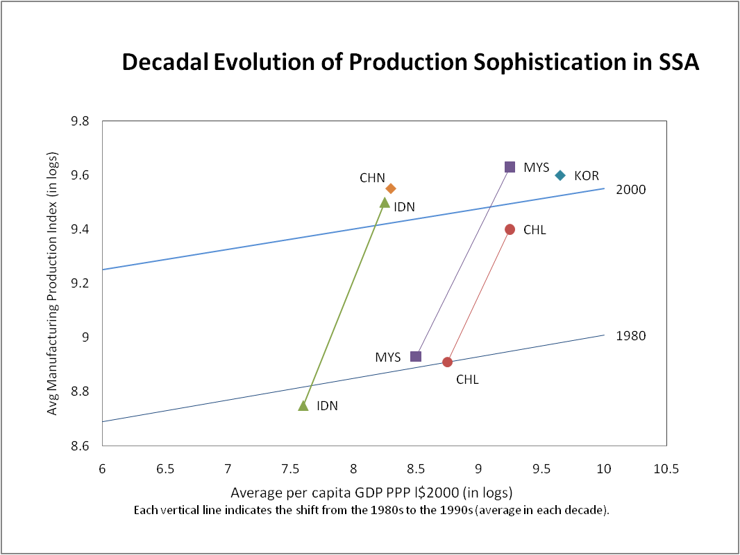
Geology is not destiny:
Structural change in production

Slide 28
A strategy for managing resource wealth:
Public investment choices
Savings can be invested in foreign or domestic assets
Rates of return should determine the choice
But it is often hard to determine the benefits of investments in institutional, physical or human capital
Need for a prioritized list of investments
“Investing to invest”
  Investing in knowledge

Slide 29
Conclusions
It’s time to take structural change seriously, again
  It’s good for growth
  It’s good for poverty reduction
Africa has the greatest structural change potential
But, since at least 1990 “perverse” structural change has reduced productivity and increased poverty

Slide 30
Conclusions
Marginal reforms may not be sufficient to reverse the trend
Three strategic options appear to hold promise
  Transforming agriculture
  Breaking in
  Managing natural resource wealth
These strategic options are not mutually exclusive
All require careful evaluation

